Slide 1
JuliaEO Workshop 2024: Introduction to Julia: Creating Packages for Earth Observational Work
Presented By: Nathanael Wong
material at https://github.com/natgeo-wong/JuliaEO2024_Nat

Slide 2
Notes
This presentation (especially the parts using Terminal) are geared towards Linux and macOS users
Some familiarity with Terminal is required (don’t worry, I’ll go through step by step)
For Windows users, I recommend using the Windows Terminal
It is also good to learn how to fiddle around and thus understand the concepts of package environment especially when developing packages

Slide 3
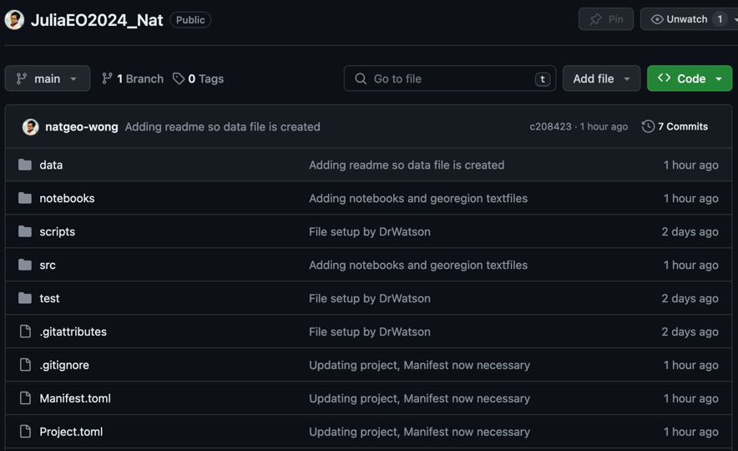
Notes
Go to https://github.com/natgeo-wong/JuliaEO2024_Nat
Clone the repository there

Slide 4
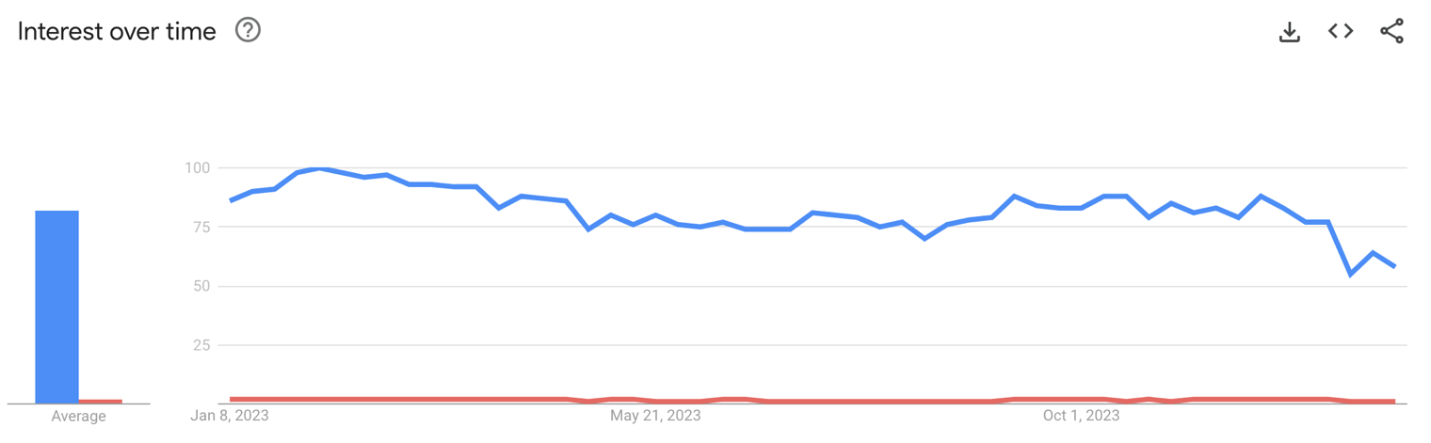
Aim
The Julia community and ecosystem is relatively small
We don’t have the wide, extensive community that Python has
A lot of packages are therefore developed by individuals like myself

Slide 5

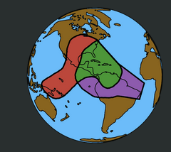
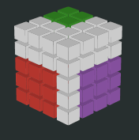
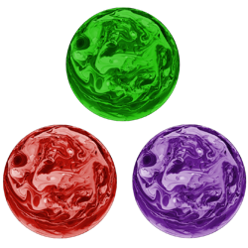
Aim
The Julia community and ecosystem is relatively small
We don’t have the wide, extensive community that Python has
A lot of packages are therefore developed by individuals like myself
Therefore, much of our development relies on the individual
This is especially true for the Earth Sciences / Geosciences and Earth Observations
If you need a specialized package, why not develop one yourself?

Slide 6
Aim
However, to develop a package, you need to understand the basics of
Julia environments and Package management
Package development in Julia

Slide 7
Outline
Understand and manage the package ecosystem in Julia
Creating Packages in Julia: What do you need to know?
Creating Packages in Julia: Using GeoRegions.jl as an Example
Applications of GeoRegions.jl
(If we have time) Creating Packages in Julia: Back to the Drawing Board!

Slide 8
Outline
Understand and manage the package ecosystem in Julia
Both for package development
And for project management, using DrWatson.jl
Creating Packages in Julia: What do you need to know?
Developing packages 101: PkgTemplates.jl, CI, and some Testing
How do you organize a package?
Best-practice/performance tips
Creating Packages in Julia: Using GeoRegions.jl as an Example
The many iterations of GeoRegions.jl

Slide 9
Outline
Applications of GeoRegions.jl
The basic functionality of GeoRegions.jl: Define, select and extract data
Using GeoRegions.jl in other Packages: What do you need to know?

Slide 10
The Julia Package Ecosystem
how do I shot web? (i.e., how to install and uninstall stuff)

Slide 11
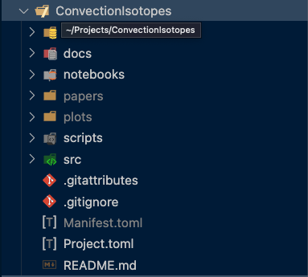
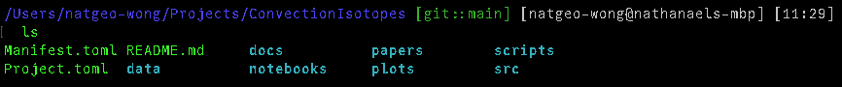
What is an Environment?
A Julia environment defines and controls
Packages used in the project
Exact specs of package (#main, version, etc.)
Defined using both Project.toml and Manifest.toml
Every project you create should have a different environment.
Why?

Slide 12
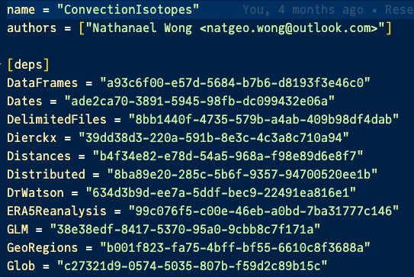
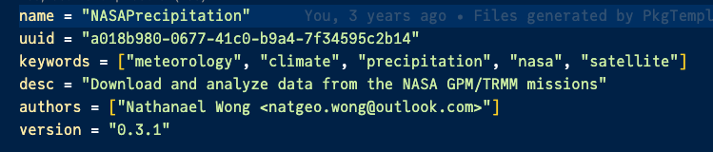
What is an Environment?
Project.toml:
contains package list
is always necessary
contains [compat] bounds of the packages
More information can be found in Pkg.jl

Slide 13
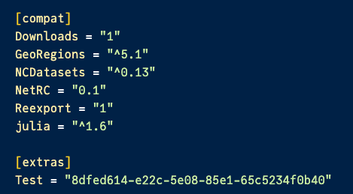
What is an Environment?
Project.toml:
contains package list
is always necessary
contains [compat] bounds of the packages
More information can be found in Pkg.jl

Slide 14
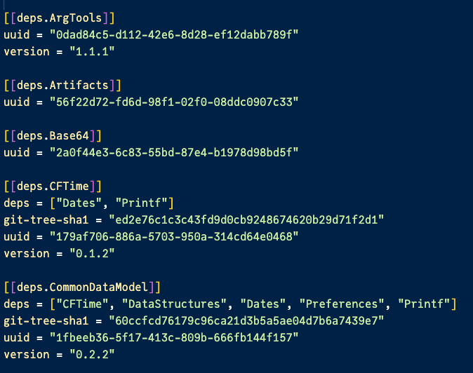
What is an Environment?
Project.toml:
contains package list
is always necessary
contains [compat] bounds of the packages
More information can be found in Pkg.jl
Manifest.toml:
contains package and dependency information
is not necessary upon startup, will be created upon project/environment initialization
is necessary an exact environment duplicate is required (e.g., for reproducibility purposes)

Slide 15
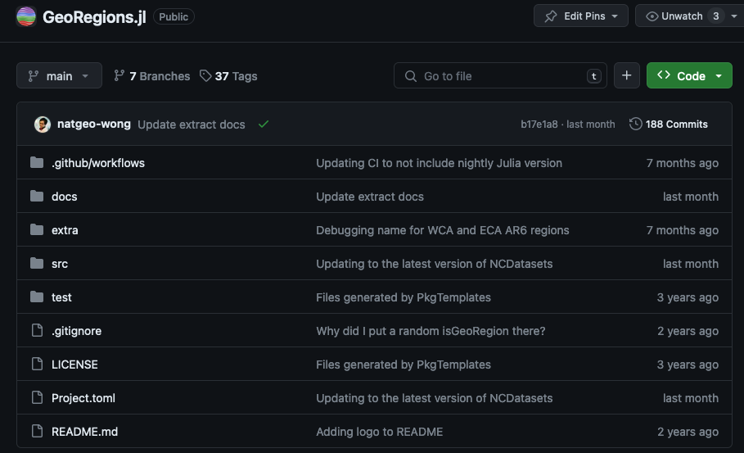
What is an Environment?
You must always have a Project.toml
A Manifest.toml can be created on-the-spot through precompilation of the environment
GitHub has no Manifest.toml

Slide 16
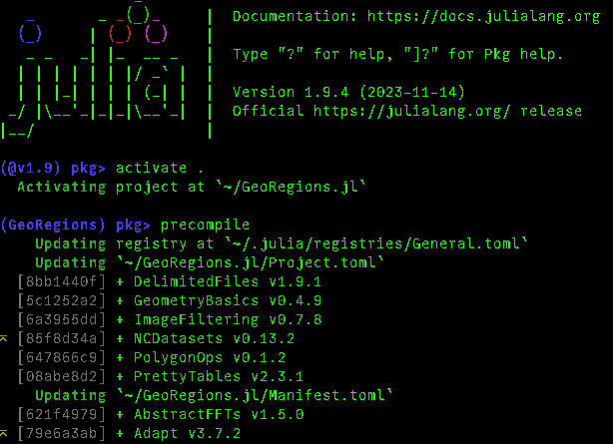
What is an Environment?
You must always have a Project.toml
A Manifest.toml can be created on-the-spot through precompilation of the environment
GitHub has no Manifest.toml
After precompilation, Manifest.toml is created

Slide 17
Activity: Creating an Environment
Now you try!

Slide 18
Activity: Creating an Environment
Now you try!
Create a folder

Slide 19
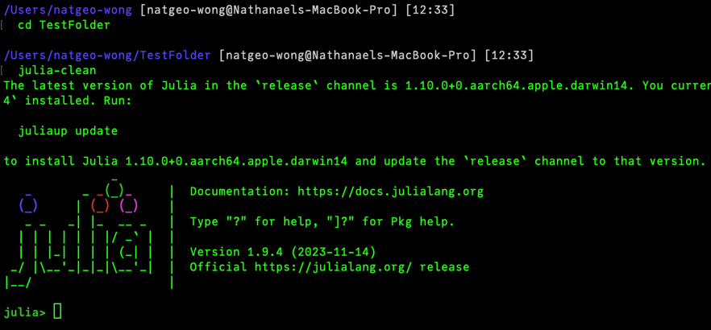
Activity: Creating an Environment
Now you try!
Create a folder
Run Julia in this folder (command: julia)

Slide 20
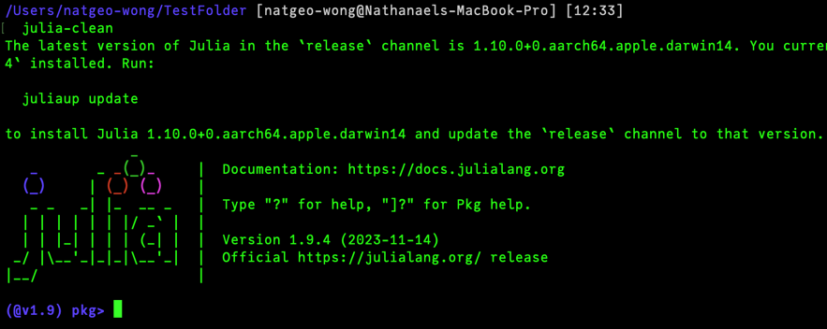
Activity: Creating an Environment
Now you try!
Create a folder
Run Julia in this folder (command: julia)
Enter the package console (command: ])

Slide 21
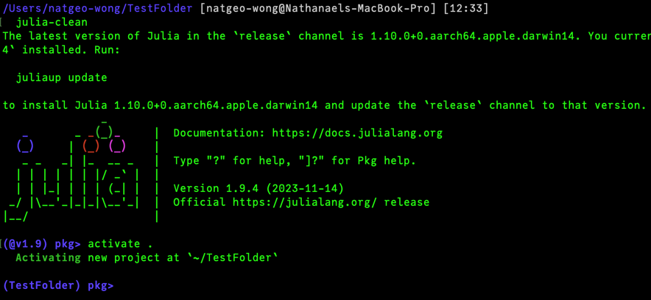
Activity: Creating an Environment
Now you try!
Create a folder
Run Julia in this folder (command: julia)
Enter the package console (command: ])
Activate the current environment (command: activate .)

Slide 22
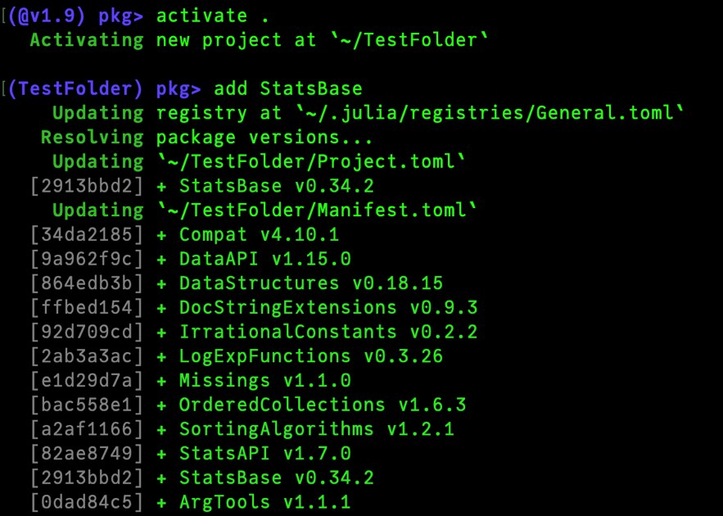
Activity: Creating an Environment
Now you try!
Create a folder
Run Julia in this folder (command: julia)
Enter the package console (command: ])
Activate the current environment (command: activate .)
Add a random package (e.g., StatsBase)

Slide 23
Activity: Creating an Environment
Now you try!
Create a folder
Run Julia in this folder (command: julia)
Enter the package console (command: ])
Activate the current environment (command: activate .)
Add a random package (e.g., StatsBase)
Your previously empty folder should now have both Project.toml and Manifest.toml

Slide 24
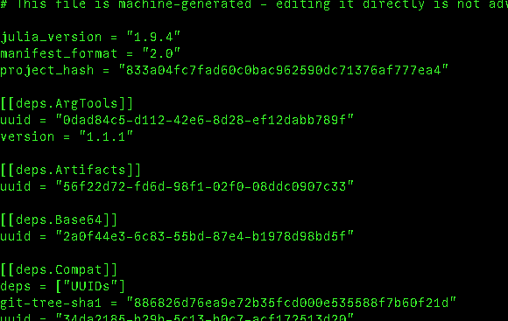
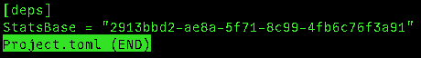
Activity: Creating an Environment
Now you try!
Create a folder
Run Julia in this folder (command: julia)
Enter the package console (command: ])
Activate the current environment (command: activate .)
Add a random package (e.g., StatsBase)
Your previously empty folder should now have both Project.toml and Manifest.toml

Slide 25
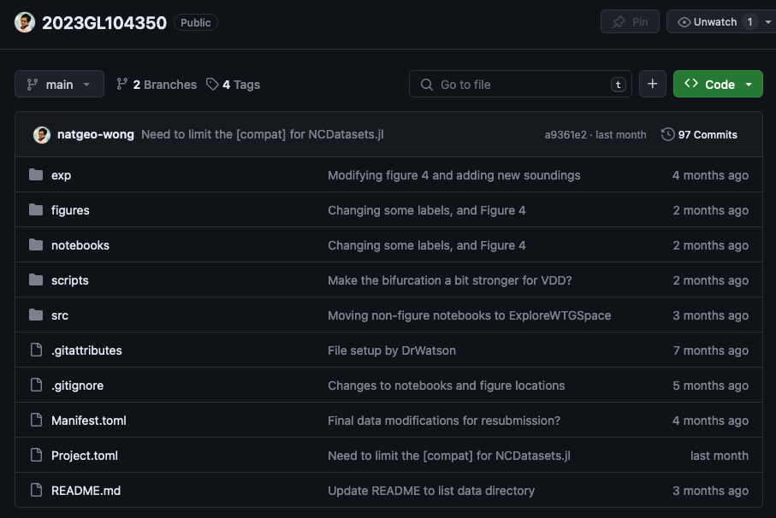
Activity: Precompiling an Environment
Now you try!
Go to https://github.com/natgeo-wong/2023GL104350 (this is my recent paper)
Clone the repository

Slide 26
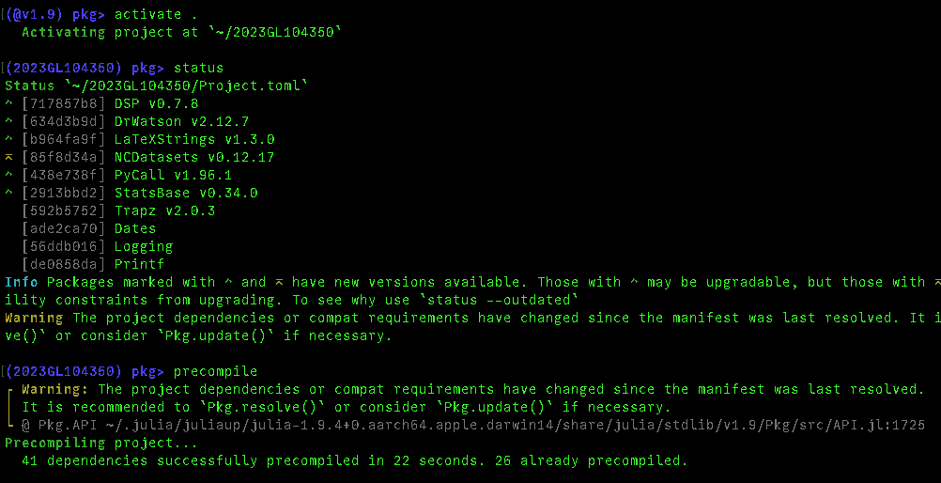
Activity: Precompiling an Environment
Now you try!
Go to https://github.com/natgeo-wong/2023GL104350 (this is my recent paper)
Clone the repository
Open Julia and activate the environment

Slide 27
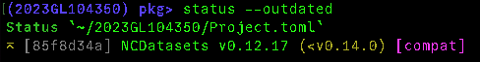
Activity: Precompiling an Environment
Now you try!
Go to https://github.com/natgeo-wong/2023GL104350 (this is my recent paper)
Clone the repository
Open Julia and activate the environment
Precompile the environment

Slide 28
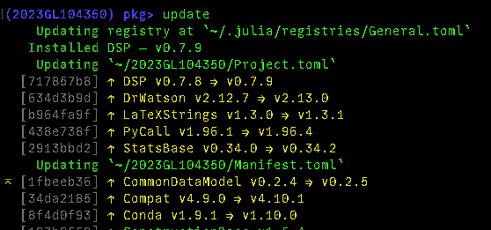
Activity: Precompiling an Environment
Now you try!
Go to https://github.com/natgeo-wong/2023GL104350 (this is my recent paper)
Clone the repository
Open Julia and activate the environment
Precompile the environment
Update the environment

Slide 29
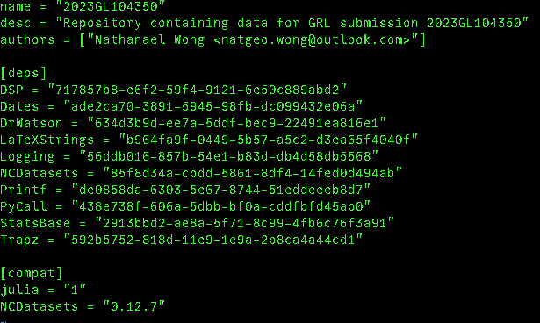
Activity: Precompiling an Environment
Now you try!
Go to https://github.com/natgeo-wong/2023GL104350 (this is my recent paper)
Clone the repository
Open Julia and activate the environment
Precompile the environment
Update the environment

Slide 30
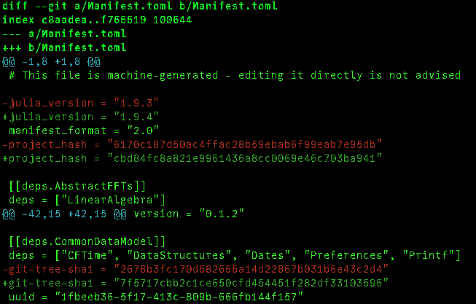
Activity: Precompiling an Environment
Now you try!
Go to https://github.com/natgeo-wong/2023GL104350 (this is my recent paper)
Clone the repository
Open Julia and activate the environment
Precompile the environment
Update the environment
Compare the difference in Manifest using git

Slide 31
Managing Environments in Package Creation
PkgTemplates.jl (https://github.com/JuliaCI/PkgTemplates.jl)
Can be used to easily create new Julia packages (we’ll get to this later)
Will setup a Package Environment by creating both Project.toml and Manifest.toml
By default, setups Git to track only the Project.toml, not the Manifest.toml

Slide 32
Managing Environments in Package Creation
PkgTemplates.jl (https://github.com/JuliaCI/PkgTemplates.jl)
Can be used to easily create new Julia packages (we’ll get to this later)
Will setup a Package Environment by creating both Project.toml and Manifest.toml
By default, setups Git to track only the Project.toml, not the Manifest.toml
You generally don’t want to track the Manifest.toml of a Package
Can anyone tell me why?

Slide 33
Managing Environments in Package Creation
PkgTemplates.jl (https://github.com/JuliaCI/PkgTemplates.jl)
Can be used to easily create new Julia packages (we’ll get to this later)
Will setup a Package Environment by creating both Project.toml and Manifest.toml
By default, setups Git to track only the Project.toml, not the Manifest.toml
You generally don’t want to track the Manifest.toml of a Package
Can anyone tell me why?
A:
[compat] requirements are already set in Project.toml
You want to allow for flexibility in dependencies, as these dependencies are likely also used by other packages in the environment
Manifest.toml will change very rapidly and will vary from device to device, not logical to track changes

Slide 34
Managing Environments for Personal Projects
DrWatson.jl (https://github.com/JuliaDynamics/DrWatson.jl)
More for creating your own self-contained projects (more on this later!)
Will setup a Project Environment by creating both Project.toml and Manifest.toml
By default, tracks both the Project.toml and Manifest.toml to ensure project reproducibility

Slide 35
Managing Environments for Personal Projects
DrWatson.jl (https://github.com/JuliaDynamics/DrWatson.jl)
More for creating your own self-contained projects (more on this later!)
Will setup a Project Environment by creating both Project.toml and Manifest.toml
By default, tracks both the Project.toml and Manifest.toml to ensure project reproducibility
The scope of this lecture mostly focuses around Package creation, not project creation, but I though it would be good to distinguish the two
Can anyone give me an example of when it is good to track/commit the Manifest.toml?

Slide 36
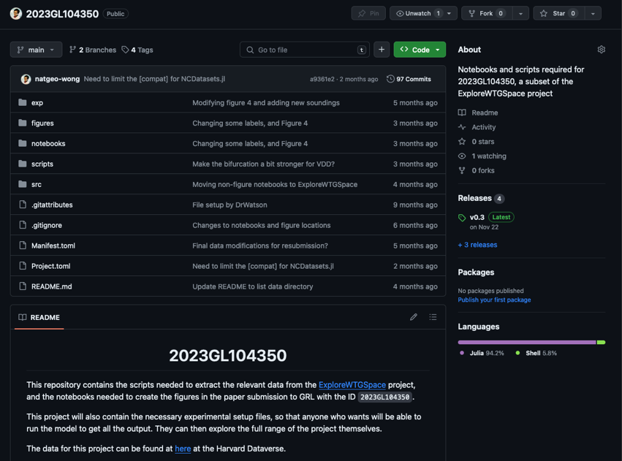
Managing Environments for Personal Projects
Paper reproducibility!
Example given just now (this is an actual repository for my paper)
This project folder was created using DrWatson.jl

Slide 37
Activity: Why different Environments?
Use DrWatson.jl to create projects called “TestProjectNew” and “TestProjectOld” Command: initialize_project(“TestProjectNew”) Command: initialize_project(“TestProjectOld”)
In the “TestProjectNew” environment, install NASAPrecipitation v0.3 Command: add NASAPrecipitation@0.2
In the “TestProjectOld” environment, install NASAPrecipitation v0.1 Command: add NASAPrecipitation@0.1
Using two different windows (loading julia in two different environments), compare and contrast NASAPrecipitation.jl

Slide 38
Activity: Why different Environments?
Using two different windows (loading julia in two different environments), compare and contrast NASAPrecipitation.jl
How do you call the different datasets?
What is the difference in keywords?
Different environments means you can load two different versions of the same package (in two separate windows)

Slide 39
Activity: Why different Environments?
Using two different windows (loading julia in two different environments), compare and contrast NASAPrecipitation.jl
How do you call the different datasets?
What is the difference in keywords?
Different environments means you can load two different versions of the same package
Note: Packages you have already loaded will remain loaded as is. (i.e., if you switch environments, the package version you have already loaded remains)

Slide 40
BREAK! (5 Mins)
Any questions?

Slide 41
Creating Packages in Julia: An Introduction
An introduction to PkgTemplates.jl and other things you need to know

Slide 42
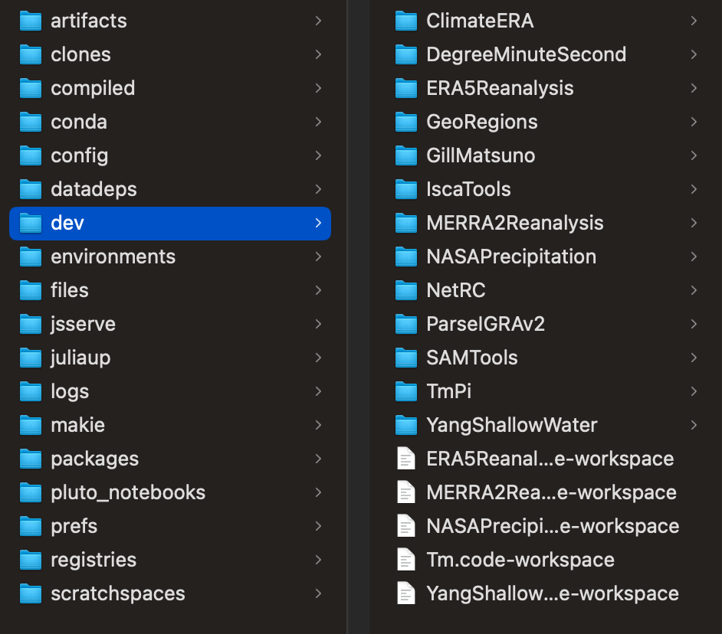
Package Creation with PkgTemplates.jl
I usually use PkgTemplates.jl to create and develop new Julia packages
PkgTemplates.jl will automatically create new packages inside ~/.julia/dev
This is the dev folder, where all packages you develop are stored
Note: You can also develop preexisting packages, just do: ]dev PkgName

Slide 43
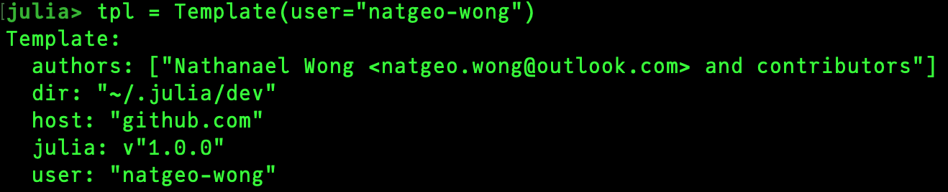
Activity: Your First Package!
Your turn! Let’s try developing your first package!
using PkgTemplates
tpl = Template()
tpl(“MyFirstPackage”)

Slide 44
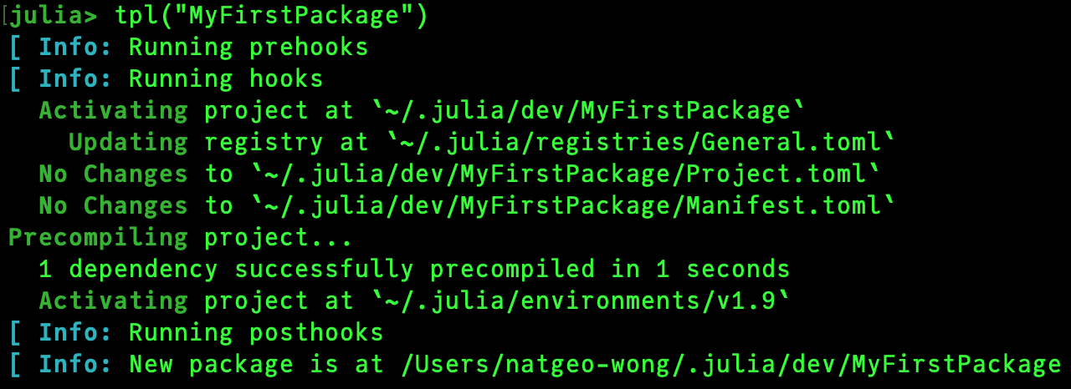
Activity: Your First Package!
Your turn! Let’s try developing your first package!
using PkgTemplates
tpl = Template()
tpl(“MyFirstPackage”)

Slide 45
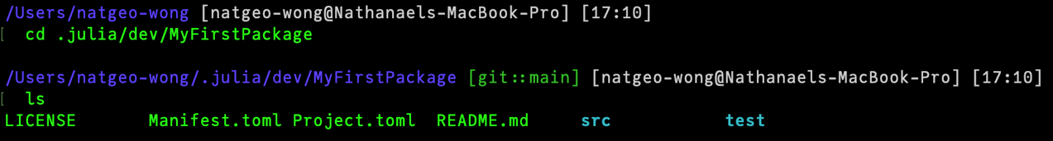
Activity: Your First Package!
Your turn! Let’s try developing your first package!
using PkgTemplates
tpl = Template()
tpl(“MyFirstPackage”)

Slide 46
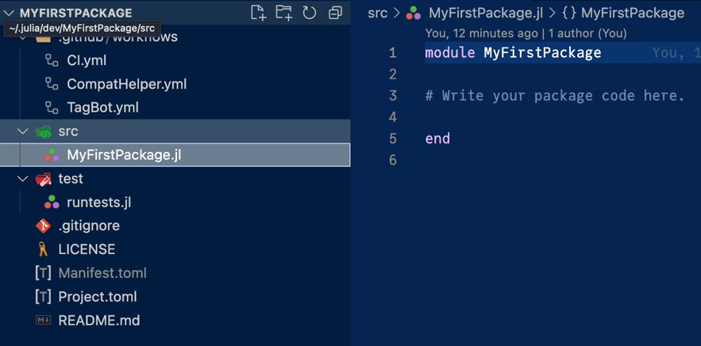
Activity: Your First Package!
Your turn! Let’s try developing your first package!
using PkgTemplates
tpl = Template()
tpl(“MyFirstPackage”)

Slide 47
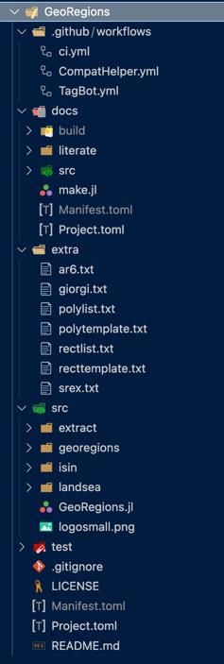
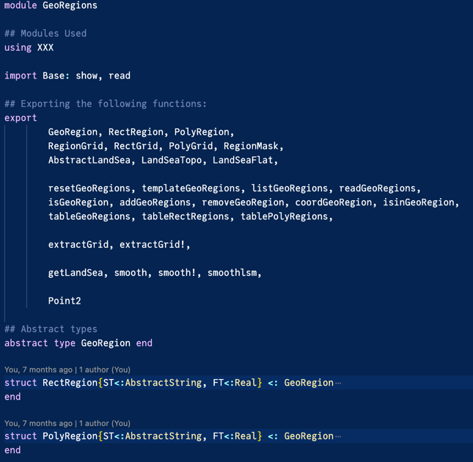
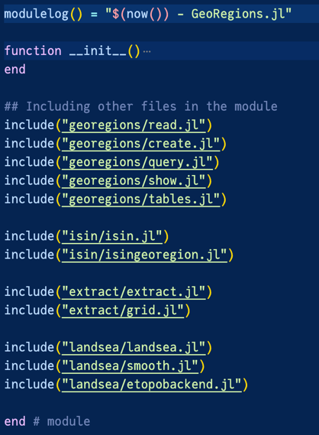
What does a fully-formed Package look like?

Slide 48
Designing a Package
What are you trying to accomplish when you are designing a package?
Let’s go around the room. What would you create a package for in Earth Observation?
Streamline workflows (e.g. downloading datasets)
Documentation of personal projects

Slide 49
Designing a Package
What are you trying to accomplish when you are designing a package?
Let’s go around the room. What would you create a package for in Earth Observation?
Data retrieval (from online servers, data repositories, etc.)
Data analysis (timeseries analysis, temporal/spatial smoothing, daily/monthly means)
Plotting and visualization of data

Slide 50
Designing a Package
What are you trying to accomplish when you are designing a package?
Let’s go around the room. What would you create a package for in Earth Observation?
Data retrieval (from online servers, data repositories, etc.)
Data analysis (timeseries analysis, temporal/spatial smoothing, daily/monthly means)
Plotting and visualization of data
What are these? They are actions that you would perform on a dataset
A package must first focus on defining these datasets and their components
How would you organize a package?

Slide 51
Designing a Package
Package
Components
Actions
Dataset
Land-Sea Mask
Variables
Geographic Region
Download
Analysis
Calculation
Filesystem

Slide 52
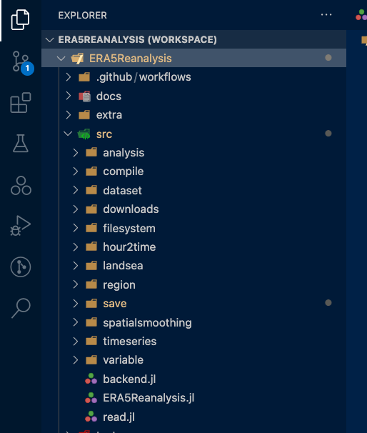
Designing a Package
See filesystem structure on the right here
Red = package filesystem
Purple = package components
Green = actionables / analysis
You also have miscellaneous backend items
Date2String functions
Error checks
Nan-means
Real2Int functions

Slide 53
Designing a Package
What does this mean?
You need to be able to know what data is available/provided
What is the package going to do for you?
You may not want to retrieve everything (e.g., is all the information relevant to you?)

Slide 54
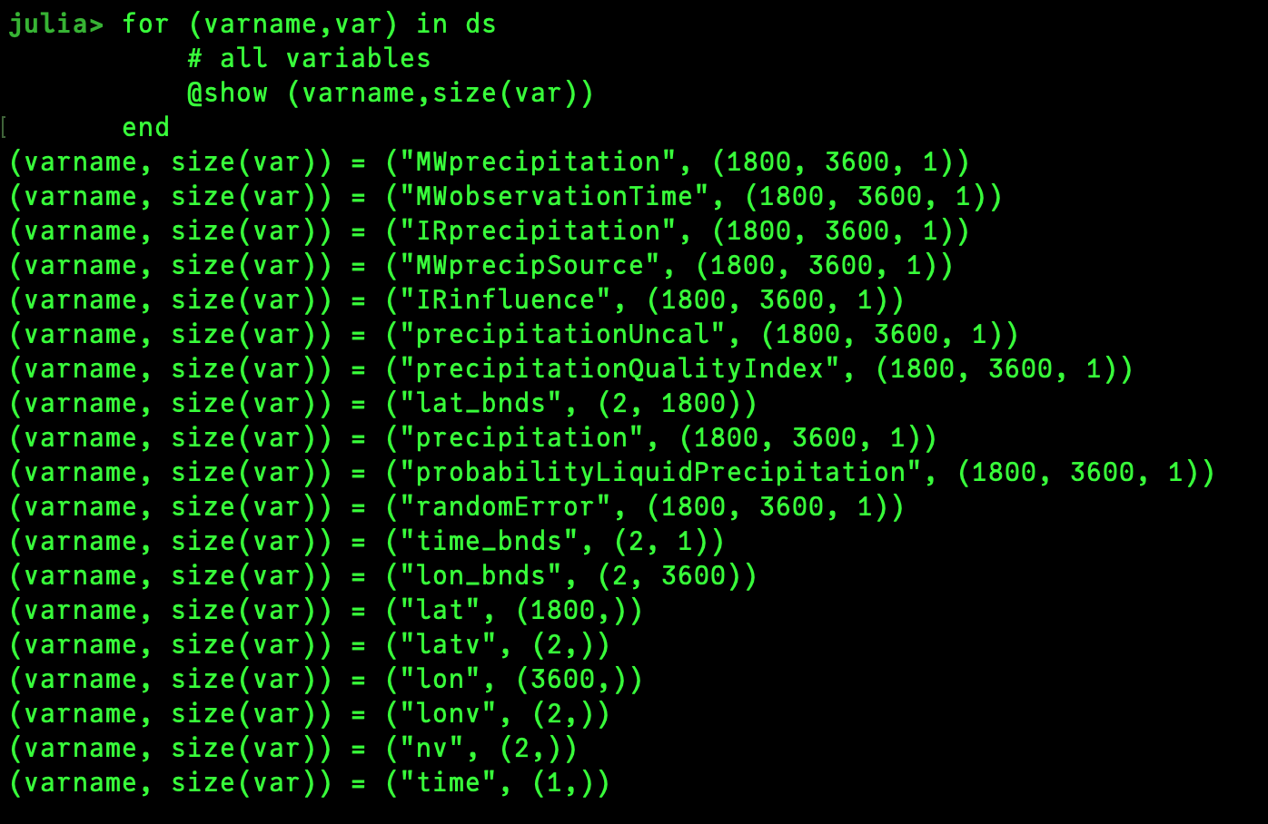
Designing a Package
What does this mean?
You need to be able to know what data is available/provided
What is the package going to do for you?
You may not want to retrieve everything (e.g., is all the information relevant to you?)
E.g., the Global Precipitation Mission provides a lot of extra data
e.g., IR Precipitation (Infrared Radar)
Do you need these data? Or just the total precipitation values?

Slide 55
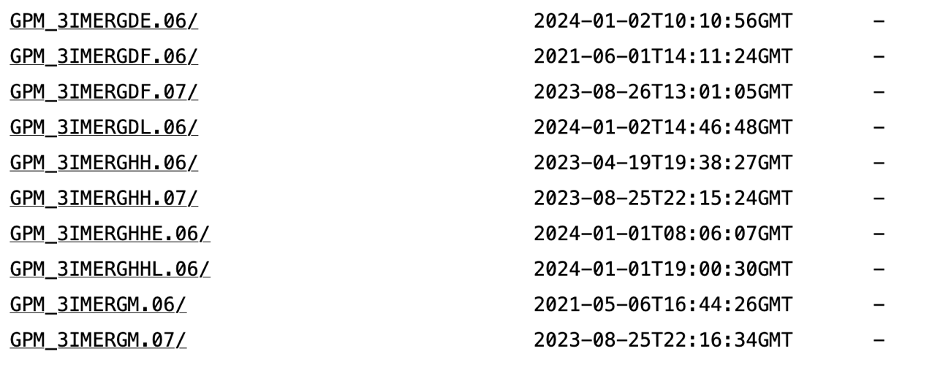
Multiple Datasets in a Package
Packages may handle multiple datasets

Slide 56
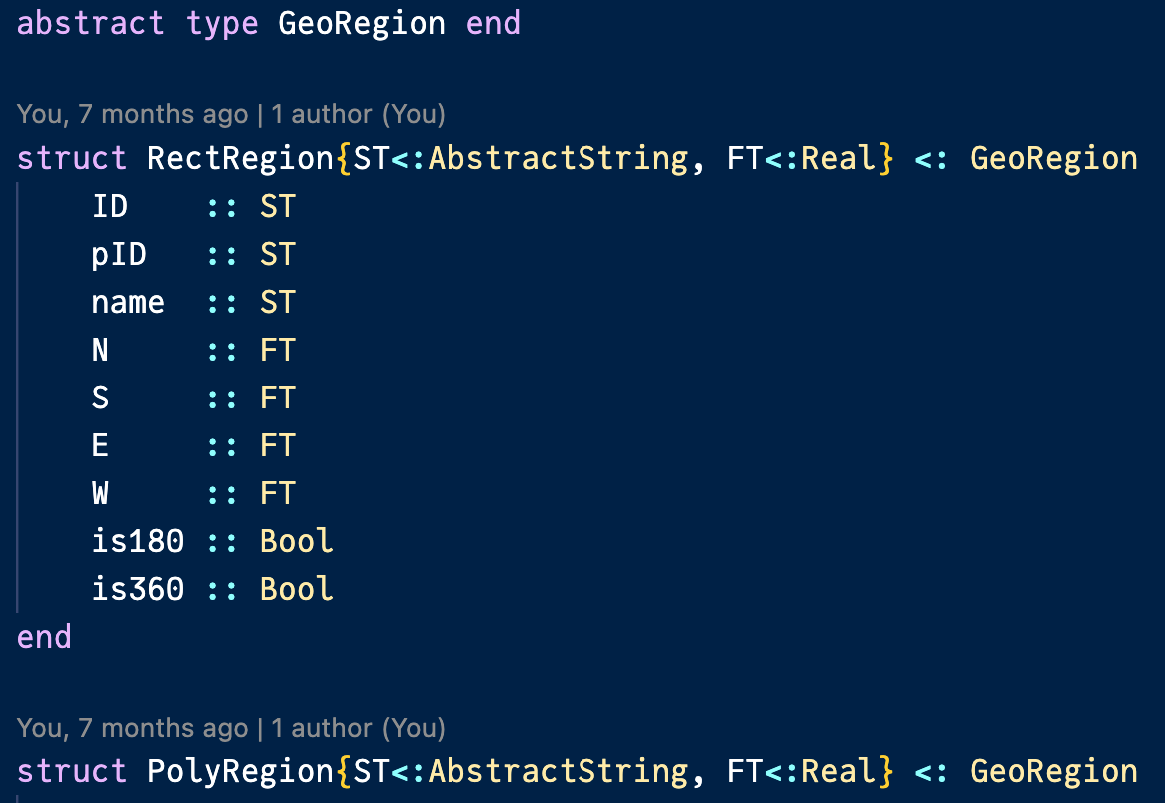
Multiple Datasets in a Package
Packages may handle multiple datasets
Each of these datasets may have different properties
Each of these datasets may have different performable actions
How do we handle multiple datasets in a single package?
Types + multiple dispatch methods!

Slide 57
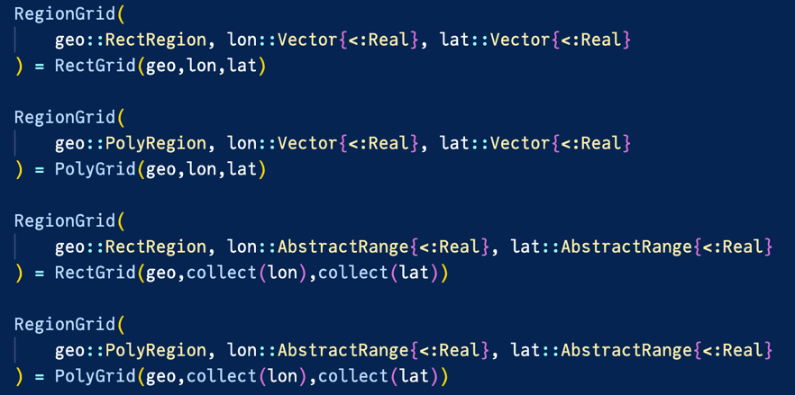
Multiple Datasets in a Package
Packages may handle multiple datasets
Each of these datasets may have different properties
Each of these datasets may have different performable actions
How do we handle multiple datasets in a single package?
Types + multiple dispatch methods!

Slide 58
Multiple Datasets in a Package
NASAPrecipitation.jl
IMERGDataset
IMERGHalfHourly
IMERGDaily
TRMMDataset
TRMM3Hourly
IMERGMonthly
TRMMDaily
TRMMMonthly

Slide 59
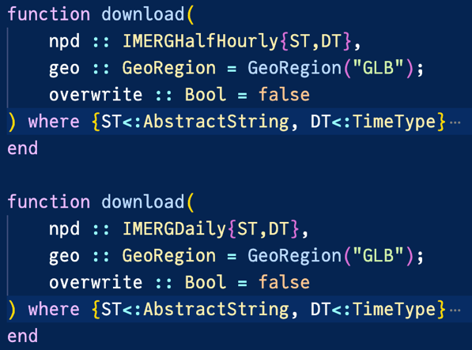
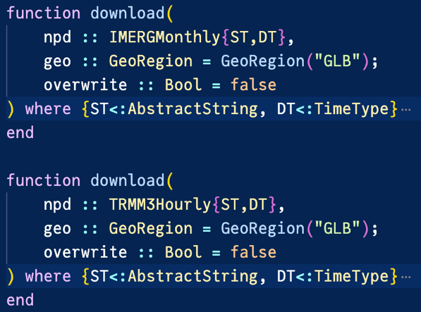
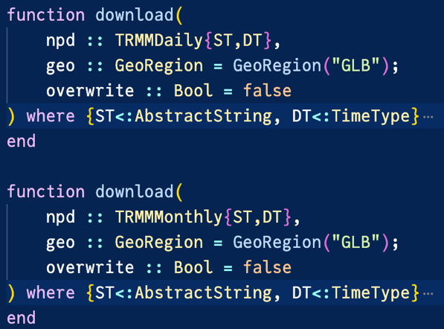
Multiple Datasets in a Package

Slide 60
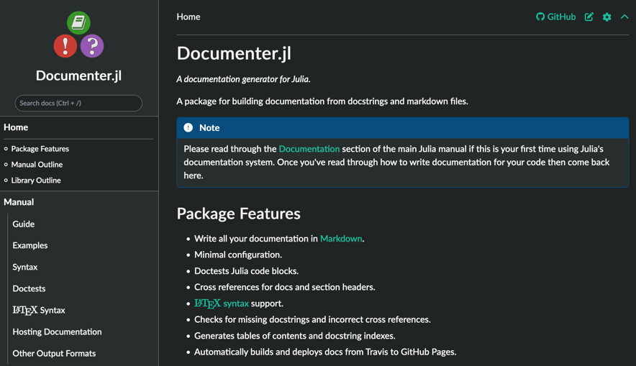
Understanding your Package
You (and your collaborators) are the designer of the package
You know your package best. Does everyone else?
A good Julia package is not only comprehensive and well-organized, but it must also be easy for people to understand
Documentation! (made using Documenter.jl)
PkgTemplates.jl will also set this up

Slide 61
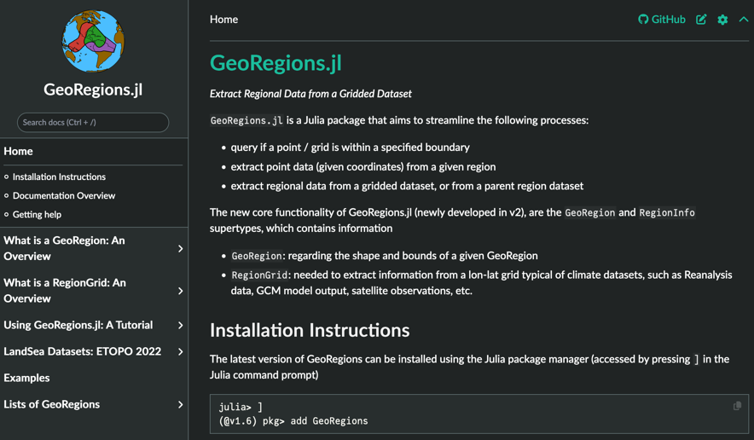
Understanding your Package
You (and your collaborators) are the designer of the package
You know your package best. Does everyone else?
A good Julia package is not only comprehensive and well-organized, but it must also be easy for people to understand
Documentation! (made using Documenter.jl)
PkgTemplates.jl will also set this up

Slide 62
TL,DR
PkgTemplates.jl is a good tool for package developers in Julia
Designing a package requires familiarity with the relevant datasets and the variables
If you want to design a package, I recommend sketching out
What your package is supposed to do
What datasets and variables are in your package, how are they accessed?
Multiple datasets can be handled using Julia types and multiple dispatch
Documentation is also necessary if you want other people to use your package!
Read through Documenter.jl for further details (I won’t be able to cover this in this lecture)

Slide 63
BREAK! (5 Mins)
Any questions?

Slide 64
Creating Packages in Julia: GeoRegions.jl as an Example
The logic behind the development of GeoRegions.jl

Slide 65
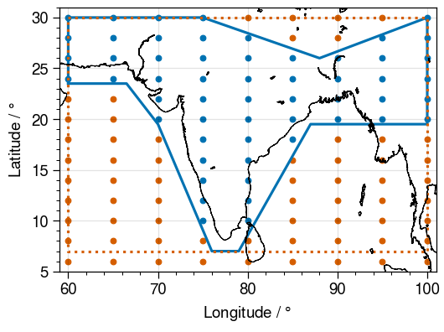
What is GeoRegions.jl?
Deals with gridded data (preferably rectilinear grids)
Specify a Geographic Area:
ID
Name
Parent Region (default is GLB)
[N,S,E,W] coordinates or longitude/latitude vectors specifying a shape
E.g.: specify region to download GPM IMERG data from OPeNDAP

Slide 66
GeoRegions.jl as an Example of a Julia Package
We will get to learning how to use GeoRegions.jl later
This section is focused on using GeoRegions.jl as an example of how to organize/structure a Julia Package
Go back and compare against some of the concepts I mentioned just now for e.g., Types, methods and multiple-dispatch, organization
Show people the thought process required

Slide 67
GeoRegions.jl as an Example of a Julia Package
Current version: v5.2.6
In 2023, it was at v3
Why did I bump it up 2 versions?

Slide 68
GeoRegions.jl as an Example of a Julia Package
Current version: v5.2.6
In 2023, it was at v3
Why did I bump it up 2 versions?
Julia follows SemVer
If you publish your package as v1, any breaking changes require you to bump your version

Slide 69
GeoRegions.jl as an Example of a Julia Package
Current version: v5.2.6
In 2023, it was at v3
Why did I bump it up 2 versions?
Julia follows SemVer
If you publish your package as v1, any breaking changes require you to bump your version
It is better to wait and ensure that your package is stable before bumping to v1 (Note that most of the packages introduced during this workshop are v0.X)

Slide 70
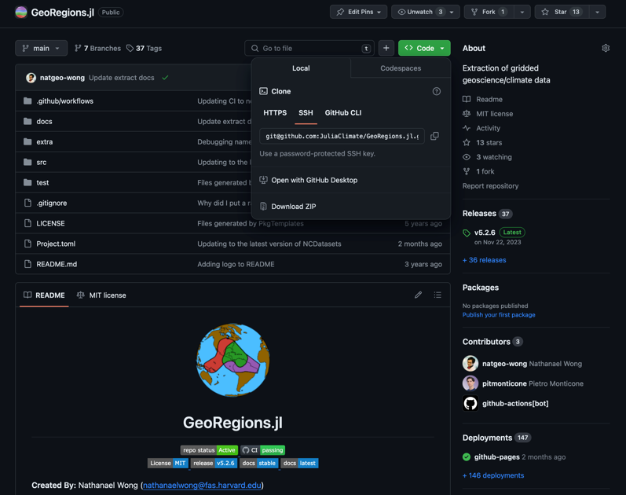
GeoRegions.jl as an Example of a Julia Package
Go to https://github.com/JuliaClimate/GeoRegions.jl and download/clone the repository
We will explore the package together

Slide 71
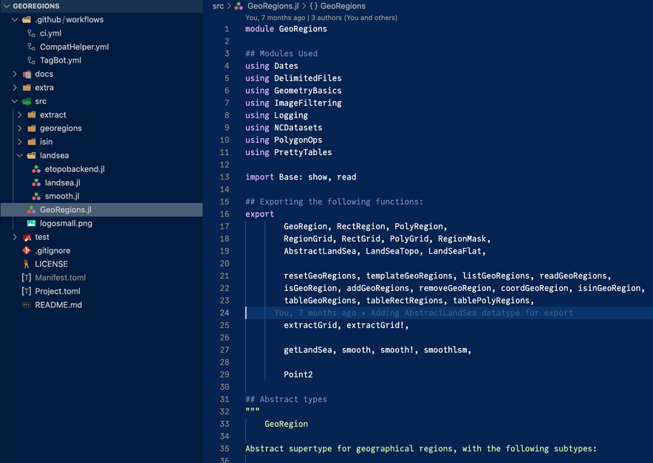
GeoRegions.jl as an Example of a Julia Package
Package
Components
Actions
What are the supertypes available in GeoRegions.jl?
N/A (filesystem handling irrelevant)
What does the package do?

Slide 72
GeoRegions.jl as an Example of a Julia Package
Package
Components
Actions
GeoRegion
Data Extraction
Is XX in YY?
RegionGrid
AbstractLandSea
ETOPO

Slide 73
GeoRegions.jl as an Example of a Julia Package
The master file of PackageName.jl is always found in src/PackageName.jl
This is the starting point of every package
In src/GeoRegions.jl, note the order of what I am doing:

Slide 74
GeoRegions.jl as an Example of a Julia Package
The master file of PackageName.jl is always found in src/PackageName.jl
This is the starting point of every package
In src/GeoRegions.jl, note the order of what I am doing:
Load the package dependencies (information contained in Project.toml)
Export the package functions and Types defined in GeoRegions.jl
Define the most important Types in your Package (preferably at least the abstract types)
Define your functions (and include other files with functions)
You can shift the order of (2/Export) around with the others

Slide 75
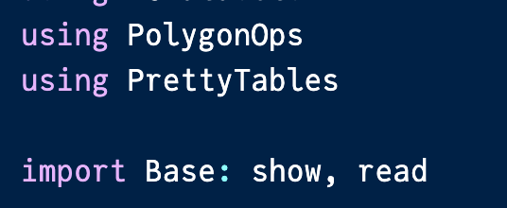
GeoRegions.jl as an Example of a Julia Package
Load the package dependencies (information contained in Project.toml)
using is okay for most cases
import is used when you want to reexport a function

Slide 76
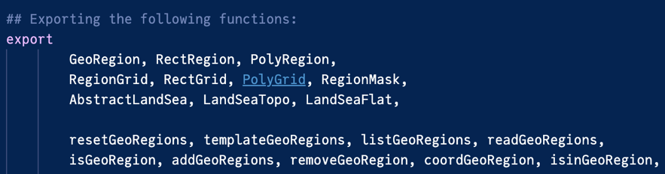
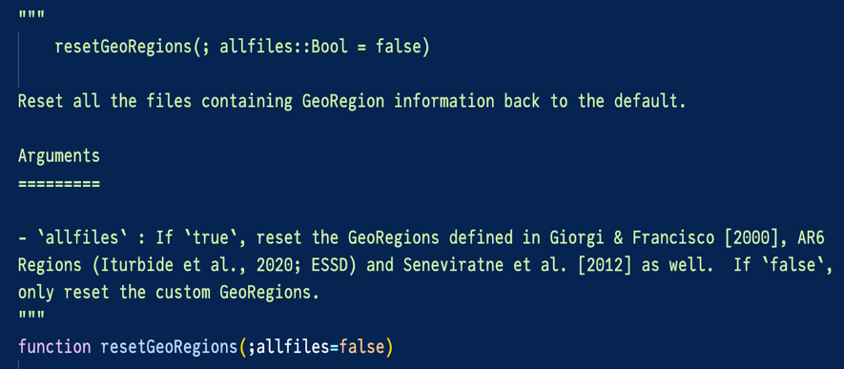
GeoRegions.jl as an Example of a Julia Package
Load the package dependencies (information contained in Project.toml)
Export the package functions and Types defined in GeoRegions.jl
Order doesn’t matter
I usually export the Types on top, then the functions below
Exporting Types is important if you are creating parent packages

Slide 77


GeoRegions.jl as an Example of a Julia Package
Load the package dependencies (information contained in Project.toml)
Export the package functions and Types defined in GeoRegions.jl
Define the most important Types in your Package (preferably at least the abstract types)
A Type must be defined first before it can be used in a function

Slide 78

GeoRegions.jl as an Example of a Julia Package
Load the package dependencies (information contained in Project.toml)
Export the package functions and Types defined in GeoRegions.jl
Define the most important Types in your Package (preferably at least the abstract types)
Define your functions (and include other files with functions)
Order of function definition doesn’t matter
Reminder: Relevant Types must be defined first

Slide 79


GeoRegions.jl as an Example of a Julia Package
Load the package dependencies (information contained in Project.toml)
Export the package functions and Types defined in GeoRegions.jl
Define the most important Types in your Package (preferably at least the abstract types)
Define your functions (and include other files with functions)
Order of function definition doesn’t matter
Reminder: Relevant Types must be defined first
This function was called first …
But was only defined later in the package …

Slide 80
GeoRegions.jl as an Example of a Julia Package
I learned all these practices by trial and error, committed to v1 too early
This is why the version is large (at v5 currently)
v1 → v2: shifted to using Types instead of Dictionaries
v2 → v3: breaking changes for dataset downloading (would require people to redownload datasets all over again)
v3 → v4: changed field names for RegionGrid Types (would break parent packages)
v4 → v5: changed field names for GeoRegion Types (would break parent packages)

Slide 81


GeoRegions.jl as an Example of a Julia Package
I learned all these practices by trial and error, committed to v1 too early
This is why the version is large (at v5 currently)
v1 → v2: shifted to using Types instead of calling Strings

Slide 82
GeoRegions.jl as an Example of a Julia Package
I learned all these practices by trial and error, committed to v1 too early
This is why the version is large (at v5 currently)
v1 → v2: shifted to using Types instead of calling Strings
GeoRegion information was loaded and stored
No need to keep calling functions again and again

Slide 83

GeoRegions.jl as an Example of a Julia Package
I learned all these practices by trial and error, committed to v1 too early
This is why the version is large (at v5 currently)
v3 → v4: changed field names for RegionGrid Types (would break parent packages)
v4 → v5: changed field names for GeoRegion Types (would break parent packages)

Slide 84
GeoRegions.jl as an Example of a Julia Package
I learned all these practices by trial and error, committed to v1 too early
This is why the version is large (at v5 currently)
v3 → v4: changed field names for RegionGrid Types (would break parent packages)
v4 → v5: changed field names for GeoRegion Types (would break parent packages)
Why did I do this?

Slide 85
GeoRegions.jl as an Example of a Julia Package
I learned all these practices by trial and error, committed to v1 too early
This is why the version is large (at v5 currently)
v3 → v4: changed field names for RegionGrid Types (would break parent packages)
v4 → v5: changed field names for GeoRegion Types (would break parent packages)
Why did I do this?
A: e.g. I felt that using “ID” was more intuitive than “regID”

Slide 86
GeoRegions.jl as an Example of a Julia Package
I learned all these practices by trial and error, committed to v1 too early
This is why the version is large (at v5 currently)
v3 → v4: changed field names for RegionGrid Types (would break parent packages)
v4 → v5: changed field names for GeoRegion Types (would break parent packages)
Why did I do this?
A: e.g. I felt that using “ID” was more intuitive than “regID”
Simpler is always better

Slide 87

GeoRegions.jl as an Example of a Julia Package
What is this section in green?

Slide 88
GeoRegions.jl as an Example of a Julia Package
It is important to provide documentation for your functions
Good documentation also provides examples and use-cases, not only API functionality

Slide 89


GeoRegions.jl as an Example of a Julia Package

Slide 90

GeoRegions.jl as an Example of a Julia Package
You can export functions, and more importantly, types, for use in other packages
e.g.,
GeoRegions.jl exports the LandSeaFlat type

Slide 91

GeoRegions.jl as an Example of a Julia Package
You can export functions, and more importantly, types, for use in other packages
e.g.,
GeoRegions.jl exports the LandSeaFlat type
NASAPrecipitation uses this type

Slide 92

GeoRegions.jl as an Example of a Julia Package
You can export functions, and more importantly, types, for use in other packages
e.g.,
GeoRegions.jl exports the LandSeaFlat type
NASAPrecipitation.jl creates a subtype of this GeoRegions type

Slide 93
GeoRegions.jl as an Example of a Julia Package
You can export functions, and more importantly, types, for use in other packages
e.g.,
GeoRegions.jl exports the LandSeaFlat type
NASAPrecipitation.jl creates a subtype of this GeoRegions type
This is how you

Slide 94
BREAK! (5 Mins)
Any questions?

Slide 95
Using GeoRegions.jl
How do I use GeoRegions.jl in Earth Observation work?

Slide 96
Breakdown of Today’s Tutorial
Using GeoRegions.jl
Defining your own GeoRegion
Properties of a GeoRegion
How do you use GeoRegions?
Data Extraction for a particular region (defined by a GeoRegion)
Is a point/region within a GeoRegion of interest?
Land-Sea Mask Datasets (retrieving and manipulating ETOPO data)
Using GeoRegions.jl in other packages

Slide 97

Breakdown of Today’s Tutorial
For this part, we will be using Pluto.jl notebooks! (https://plutojl.org)
Good for step-by-step story format presentation
Interactive and in-real-time
I like using Pluto.jl notebooks to do data visualization and presentation

Slide 98
Breakdown of Today’s Tutorial
Today’s notebooks are not a exhaustive tutorial of the functionalities of GeoRegions.jl
For a more comprehensive breakdown, it is always best to refer to the documentation
Today’s introduction to GeoRegions.jl is more to reinforce concepts taught earlier, i.e.,
how do you want to design a package and what is it supposed to do?
using Types and multiple dispatch
exporting package functionality for future use (e.g., how GeoRegions.jl Types can be exported for use in parent packages such as NASAPrecipitation.jl)

Slide 99
Breakdown of Today’s Tutorial
Go to https://github.com/natgeo-wong/JuliaEO2024_Nat
Clone the repository there

Slide 100
Opening the notebooks
First, you need to setup the environment?
Recall, what do you need to do?
Precompile the environment!

Slide 101

Opening the notebooks
Go into the notebooks folder
Run Julia
Loading the Pluto.jl package (using Pluto)
Open a Pluto notebook session (Pluto.run())

Slide 102

Opening the notebooks
Go into the notebooks folder
Run Julia
Loading the Pluto.jl package (using Pluto)
Open a Pluto notebook session (Pluto.run())
From there, you can open Pluto notebooks

Slide 103
Opening the notebooks
Go into the notebooks folder
Run Julia
Loading the Pluto.jl package (using Pluto)
Open a Pluto notebook session (Pluto.run())
From there, you can open Pluto notebooks
We will go in order from 01 to 04

Slide 104
Notebooks Time!
We’ll be using notebooks for this part of the lecture

Slide 105
Creating Packages in Julia: A Summary

Slide 106
Why do you want to create a package?
Package
Components
Actions
Dataset
Land-Sea Mask
Variables
Geographic Region
Download
Analysis
Calculation
Filesystem

Slide 107
Why do you want to create a Package?
A key part of creating a package is understanding Julia environments
Understand the basics of environment creation, activation, compilation and updating
Understand the purpose of a Project.toml and a Manifest.toml
Each package has its own environment
Every project you have should also have its own environment
Not recommended to use the master environment unless it’s for basic testing stuff
Different projects can have different package versions for different use-cases

Slide 108
Why do you want to create a Package?
What are you trying to accomplish when you are designing a package?
Data retrieval (from online servers, data repositories, etc.)
Data analysis (timeseries analysis, temporal/spatial smoothing, daily/monthly means)
Plotting and visualization of data
Design your package such that it is easy for people to use and understand
An understanding of types and multiple dispatch helps a lot in organizing your package
Clear documentation also helps a lot

Slide 109
The End
Thanks for listening!

